Slide 1
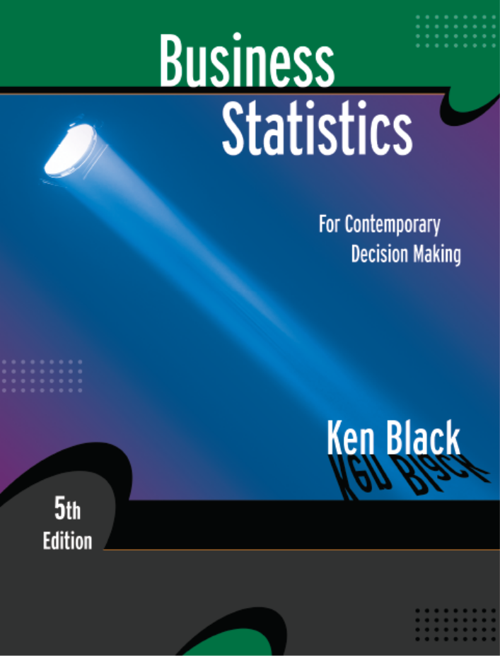
Business Statistics, 5th ed. by Ken Black
Chapter 5
Discrete
Distributions
PowerPoint presentations prepared by Lloyd Jaisingh, Morehead State University

Slide 2
Learning Objectives
Distinguish between discrete random variables and continuous random variables.
Know how to determine the mean and variance of a discrete distribution.
Identify the type of statistical experiments that can be described by the binomial distribution, and know how to work such problems.
Notes:
2

Slide 3
Learning Objectives -- Continued
Decide when to use the Poisson distribution in analyzing statistical experiments, and know how to work such problems.
Decide when binomial distribution problems can be approximated by the Poisson distribution, and know how to work such problems.
Decide when to use the hypergeometric distribution, and know how to work such problems.
Notes:
3

Slide 4
Discrete vs. Continuous Distributions
Random Variable -- a variable which contains the outcomes of a chance experiment
Discrete Random Variable -- the set of all possible values is at most a finite or a countably infinite number of possible values
  Number of new subscribers to a magazine
  Number of bad checks received by a restaurant
  Number of absent employees on a given day
Continuous Random Variable -- takes on values at every point over a given interval
  Weight of the people
  Arrival time interval of customers at bank
  Percent of the labor force that is unemployed
Notes:
4

Slide 5
Some Special Distributions
Discrete
  binomial
  Poisson
  hypergeometric
Continuous
  uniform
  normal
  exponential
  t
  chi-square
  F
Notes:
5

Slide 6
Discrete Distribution -- Example
Distribution of Daily Crises
P
r
o
b
a
b
i
l
i
t
y
Number of Crises
Probability
0.5
0.4
0
1
2
3
4
5
0.37
0.31
0.18
0.09
0.04
0.01
0.3
0.2
0.1
0
0
1
2
3
4
5
Number of Crises
Notes:
6

Slide 7
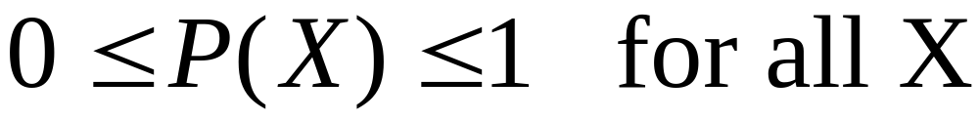
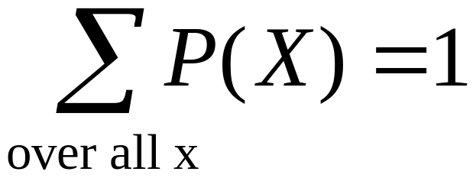
Requirements for a
Discrete Probability Function
Probabilities are between 0 and 1, inclusively
Total of all probabilities equals 1
Notes:
7

Slide 8
Requirements for a Discrete
Probability Function -- Examples
X
P(X)
X
P(X)
X
P(X)
-1
0
1
2
3
.1
.2
.4
.2
.1
1.0
-1
0
1
2
3
-.1
.3
.4
.3
.1
1.0
-1
0
1
2
3
.1
.3
.4
.3
.1
1.2
PROBABILITY
DISTRIBUTION
:
YES
NO
NO
Notes:
8

Slide 9
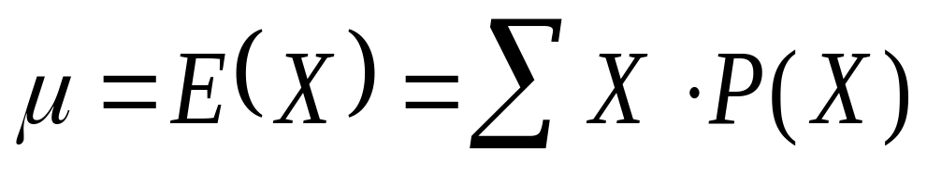
Mean of a Discrete Distribution
X
⋅
P
(
X
X
P(X)
)
-1
0
1
2
3
.1
.2
.4
.2
.1
-.1
.0
.4
.4
.3
1.0
μ = 1.0
Notes:
9

Slide 10
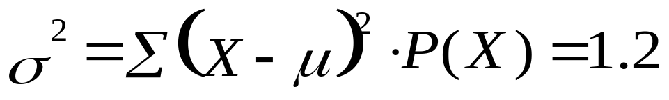
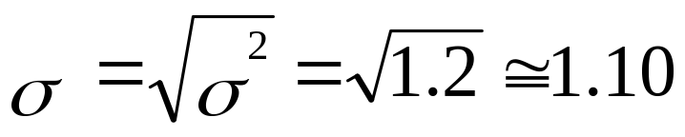


Variance and Standard Deviation of a Discrete Distribution
X
P(X)
X
−
μ
-1
0
1
2
3
.1
.2
.4
.2
.1
-2
-1
0
1
2
4
1
0
1
4
.4
.2
.0
.2
.4
1.2
Notes:
10

Slide 11
Binomial Distribution
Experiment involves n identical trials
Each trial has exactly two possible outcomes: success and failure
Each trial is independent of the previous trials
p is the probability of a success on any one trial
q = (1-p) is the probability of a failure on any one trial
p and q are constant throughout the experiment
X is the number of successes in the n trials
Applications
  Sampling with replacement
  Sampling without replacement -- n < 5% N
Notes:
13

Slide 12
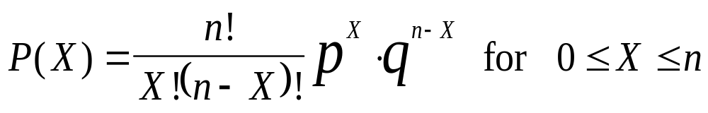

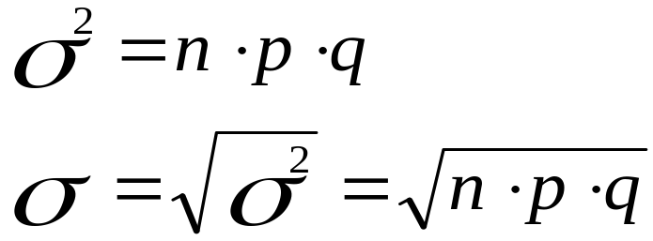
Binomial Distribution
Probability function
Mean value
Variance and standard deviation
Notes:
14

Slide 13
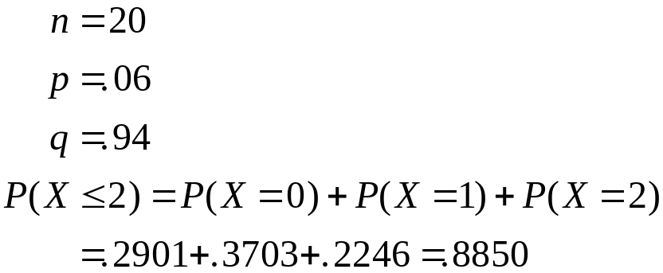
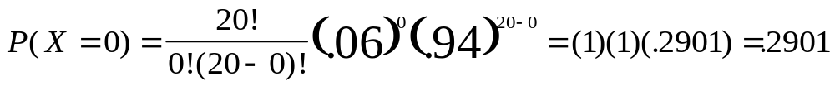
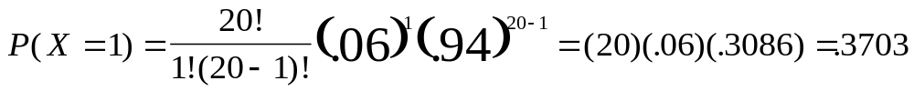
Binomial Distribution:
According to the U.S. Census Bureau, approximately 6% of all workers in Jackson, Mississippi, are unemployed. In conducting a random telephone survey in Jackson, what is the probability of getting two or fewer unemployed workers in a sample of 20?
Notes:
20

Slide 14
Graphs of Binomial Distributions
n = 4
PROBABILITY
X
0.1
0
0.656
1
0.292
2
0.049
3
0.004
4
0.000
P = 0.1
1.000
0.900
0.800
0.700
0.600
P(X)
0.500
0.400
0.300
0.200
0.100
0.000
0
1
2
3
X
4

Slide 15
Poisson Distribution
Describes discrete occurrences over a continuum or interval
A discrete distribution
Describes rare events
Each occurrence is independent of any other occurrences.
The number of occurrences in each interval can vary from zero to infinity.
The expected number of occurrences must hold constant throughout the experiment.
Notes:
32

Slide 16
Poisson Distribution: Applications
Arrivals at queuing systems
  airports -- people, airplanes, automobiles, baggage
  banks -- people, automobiles, loan applications
  computer file servers -- read and write operations
Defects in manufactured goods
  number of defects per 1,000 feet of extruded copper wire
  number of blemishes per square foot of painted surface
  number of errors per typed page
Notes:
33

Slide 17
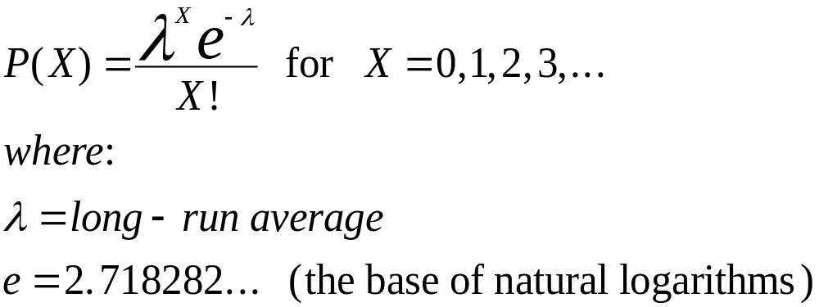
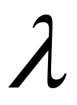
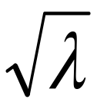
Poisson Distribution
Probability function
Mean value
Variance
Standard deviation
Notes:
34

Slide 18
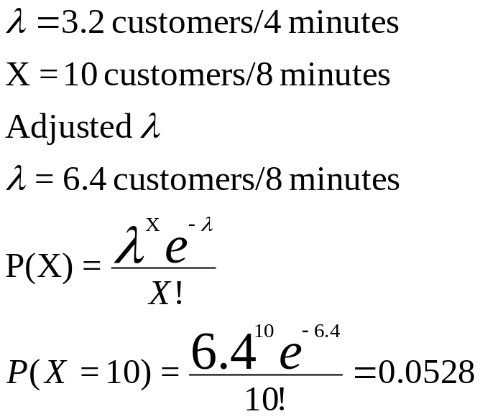
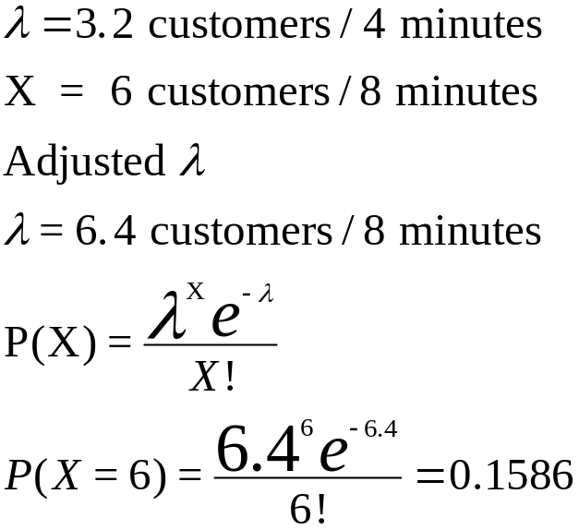
Poisson Distribution:
Banks customers arrive randomly on weekday afternoon at an average of 3.2 customers in a 4-minutes. What is the probability of having more than seven customers in a 4-minute interval on a weekday afternoon?
Notes:
35

Slide 19

Poisson Approximation of the Binomial Distribution
Binomial probabilities are difficult to calculate when n is large.
Under certain conditions binomial probabilities may be approximated by Poisson probabilities.
Poisson approximation
Notes:
41

Slide 20
Hypergeometric Distribution
Sampling without replacement from a finite population
The number of objects in the population is denoted N.
The number of objects in the sample is denoted by n
Each trial has exactly two possible outcomes, success and failure.
Trials are not independent
x is the number of successes in the sample
A is the number of success in the population
The binomial is an acceptable approximation, if n < 5% N. Otherwise it is not.
Notes:
25

Slide 21
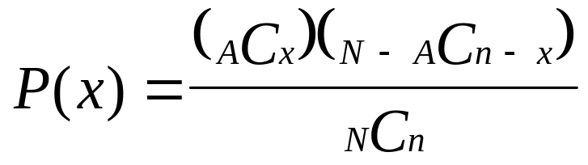
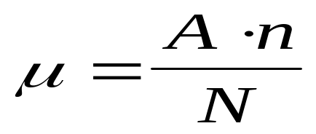
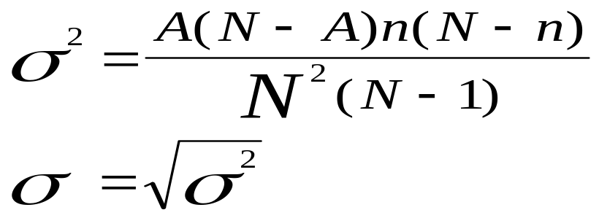
Hypergeometric Distribution
Probability function
  N is population size
  n is sample size
  A is number of successes in population
  x is number of successes in sample
Mean value
Variance and standard deviation
Notes:
26

Slide 22
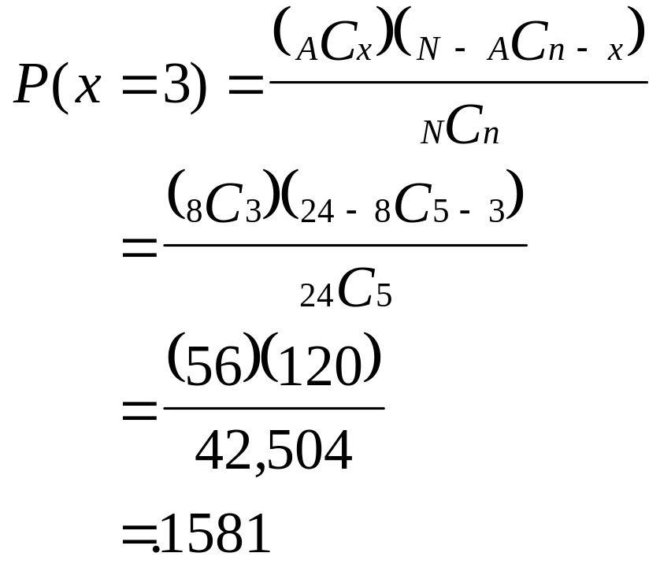
Hypergeometric Distribution:
Probability Computations
N = 24
A= 8
n = 5
x
P(x)
0
0.1028
1
0.3426
2
0.3689
3
0.1581
4
0.0264
5
0.0013
Notes:
27

